Slide 1


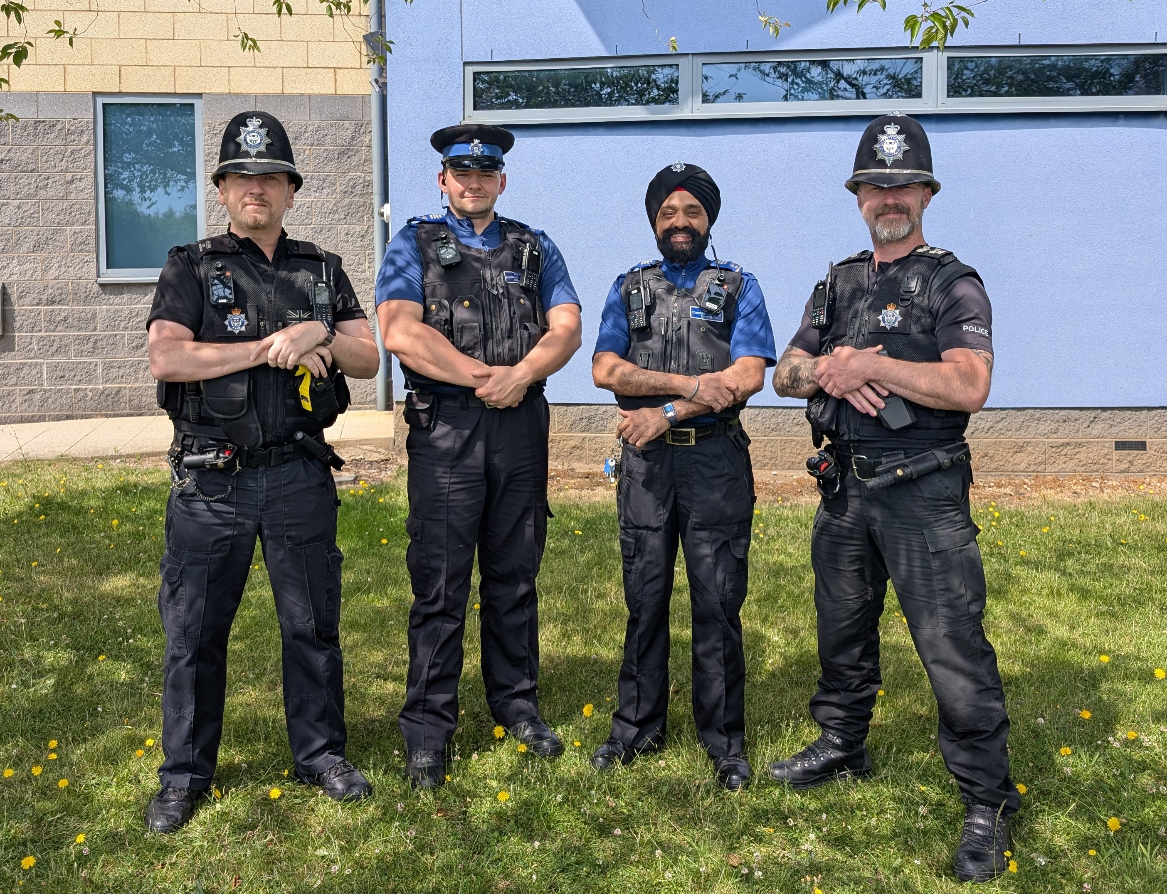

Clarendon Park Newsletter
Issue: November 2026
Meet your team
PC 4599 Des Bausor
PCSO 6652 Paul Williams
PCSO 6614 Ammo Sanghera
PS 1845 Mike Green
PCSO 6588 Michelle Holton
(replaced PCSO 6652 Paul Williams)
What matters to you
These identified priorities are based on feedback gathered through local community surveys and supported by police data. PRIORITY 1: You Said: Drugs related issues across Clarendon Park.
PRIORITY 2: You Said: Vehicles being driven in an Anti-social behaviour manner on Granville Road.
PRIORITY: 3:You Said: Thefts and shoplifting, particularly on Queens Road.
What We Did
ACTION: GRANVILLE ROAD CAR PARK ASB: officers have issued Section 59 warnings to drivers using vehicles in an anti-social manner, causing Harassment, Alarm and Distress We will continue to conduct visible patrols and work with Leicester City council parks team, to ensure it is a safe environment at this location, especially in the late evenings.
ACTION: DRUG DEALING: Your local Neighbourhood beat officers, and our proactive team has been patrolling the area and gathering intelligence, conducting stop searches of persons found to be dealing.
ACTION: THEFTS/SHOPLIFTING QUEENS RD: Your local Neighbourhood beat officers has been engaging with local shops on Queens Road to prevent and lower shoplifting, PC Gray and PC Rodgers who are our dedicated officers for retail crime who successfully managed to arrest persons.

Slide 2
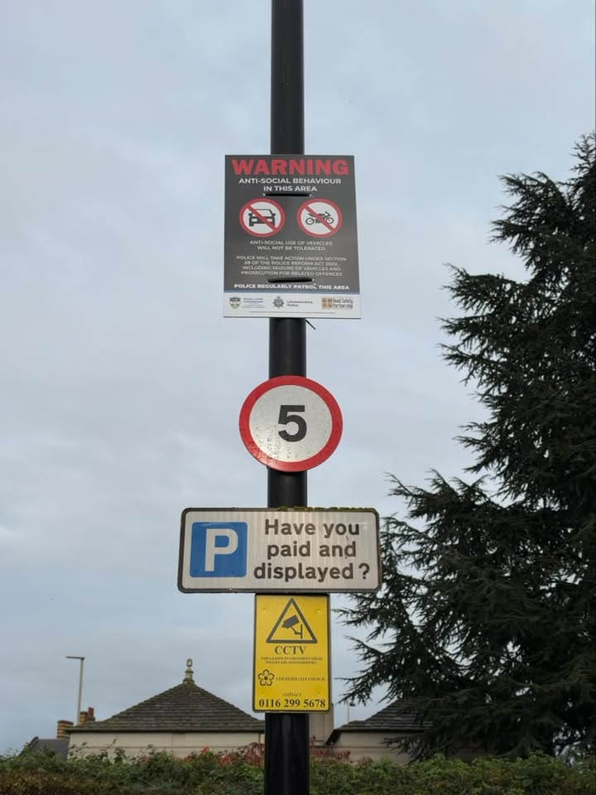
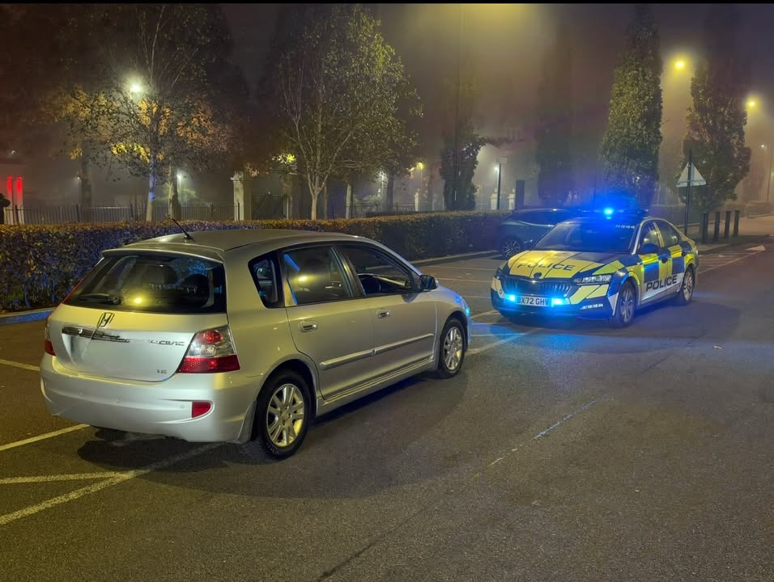
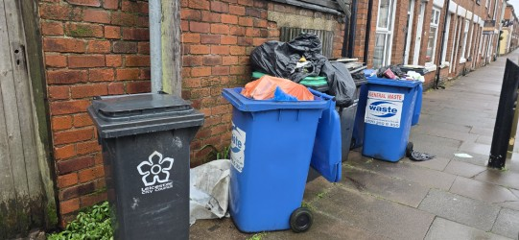
Clarendon Park Newsletter
Issue: November 2026
Community engagements
November 2026—Local Officer Drop-Ins:
•Wednesday 13 November 2026—11:00-12:00—Northern Cobbler Queens Road. -PCSO 6588
•Monday 16 November 2026—17:00 - 18:00—Morrisons Superstore. - PCSO 6614
•Saturday 21 November 2026—11:00-12:00—Victoria Park Police office (near Pavilion) -PCSO 6614
•Thursday 26 November 2026—18:00-19:00—Odeon Cinema. - PCSO 6614
•Monday 30 November 2026—10:00-11:00—Guru Amar Das Gurdwara -PCSO 6614
If you have any local issues or would just like some crime prevention advice, please pop by to one of these sessions. No appointment necessary.
Highlights from the month
Working alongside our partners, several improvements have now been introduced throughout the Granville Rd car park. New warning signage has been installed, highlighting that anti-social use of vehicles will not be tolerated and that police can take action under Section 59 of the Police Reform Act 2002.
Officers were out on the car park and took positive action!
A vehicle was stopped after being driven at excessive speed and in a manner likely to cause alarm, harassment and distress.
The driver admitted driving at speeds more than 45 mph, The driver was dealt with, and the vehicle was seized using Section 59 powers.
While out on patrols, residents brought this issue to our attention. The overflowing bins and waste were affecting the appearance of the area and causing an obstruction on the pavement.
submitted a report through Love Clean Streets so the matter can be assessed and addressed by the relevant department.

